Slide 1


eDelivery AS4
9 maart 2023

Slide 2
eDelivery AS4
eDelivery en eDelivery AS4
Functionaliteit eDelivery AS4
Toepassing Internationaal en Nationaal
Verschil in Toepassing
Nieuwe Ontwikkelingen
eDelivery AS4 Implementaties
Digikoppeling

Slide 3

eDelivery en eDelivery AS4
eDelivery is een door de EU gekozen set van standaarden t.b.v. gegevensuitwisselingen vergelijkbaar met Digikoppeling
De eDelivery standaard wordt beheerd door DG_DIGIT
Binnen eDelivery zijn er profielen gedefinieerd voor zowel ebMS3 als voor REST API’s
eDelivery AS4 is een profiel op basis van ebMS3 AS4:
eDelivery AS4 = ebMS3 AS4 + extensies

Slide 4
Functionaliteit eDelivery AS4
eDelivery AS 4
Profielen
(OASIS) AS 4
(OASIS) ebMS 3
SML/SMP
Functionaliteit
Non Repudiation

Slide 5
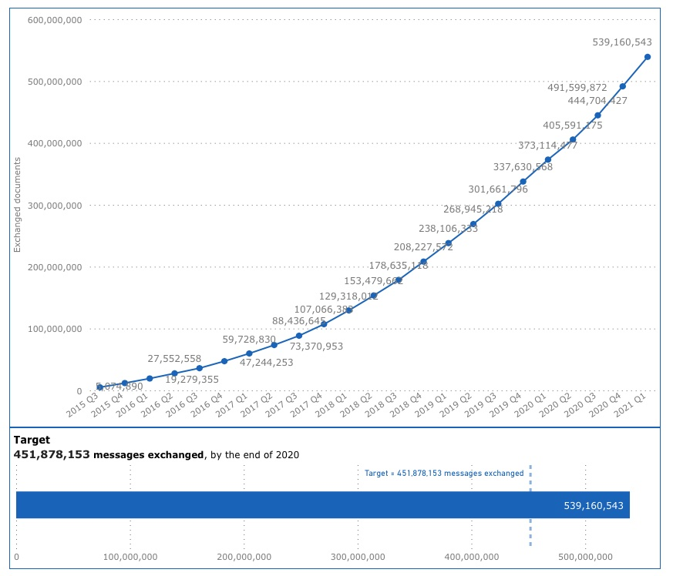
Gebruik Internationaal en Nationaal
eDelivery AS4 is binnen EU de standaard voor internationaal gegevensuitwisseling, basis bouwblok voor vele grote EU projecten (b.v. SDG/OOTS)
Voorbeelden Internationale toepassing:
E-CODEX
EESSI
BORIS
PEPPOL
Voorbeelden Nationale toepassing:
Energie Sector (EDSN)
EDI4Steel
eProcurement (PEPPOL)
ECHA
ENTSOG
EPREL
TACHOnet
ICS2
…
https://ec.europa.eu/digital-building-blocks/wikis/display/CEFDIGITAL/eDelivery+dashboard

Slide 6
Verschil in Toepassing
E-CODEX:
Point-to-Point
Statische Configuratie
PEPPOL:
Point-to-Point
SML/SMP (Discovery)
Eigen (PEPPOL) PKI
EESSI:
Point-to-Point (Via Nationale Access Points)
CSN (Registratie, Distributie)
TESTA PKI voor verkeer tussen AP’s
‘Publieke’ PKI voor nationale applicaties
BORIS:
Ster Netwerk (Centraal Register)
eDelivery AS 4
(OASIS) AS 4
(OASIS) ebMS 3
SML/SMP
Non Repudiation

Slide 7
Nieuwe Ontwikkelingen
The eDelivery AS4 profile is being updated. Its main changes relate to the security algorithms used. The profile will introduce ECC-based signing and encryption as its nominal model and downgrade RSA-based signing to legacy status, in line with other AS4 profiles in Europe. It will separate:
Long-lived certificates used for signing and encrypting messages, normally issued by Certification Authorities
Short-lived (ephemeral) encryption keys. These keys are generated by the parties directly and shared bilaterally rather than via a registry as they are specific to an individual counterparty.
It will also add a new feature for updates of security tokens based on OASIS ebCore Agreement Update. This protocol supports using secure messages for securely updating both long-lived and short-lived security tokens, similar to modern security protocols as used in IM apps like Signal.
It allows an approach similar to management of user accounts in enterprises: an initial process to be onboarded to an organization (usually involving some approval steps, initial setup of passwords and/or tokens) after which the user can self-manage (periodically changing passwords etc.), except for exceptional situations like forgotten or expired passwords that may trigger a re-onboarding.
The updated eDelivery profile specifications will first go through a public review. Products implementing eDelivery need to be adapted to support the new functionality. It will therefore only become relevant for future versions, well after December 2023.

Slide 8
































eDelivery AS4 Implementaties
https://ec.europa.eu/digital-building-blocks/wikis/display/DIGITAL/eDelivery+AS4+conformant+solutions

Slide 9
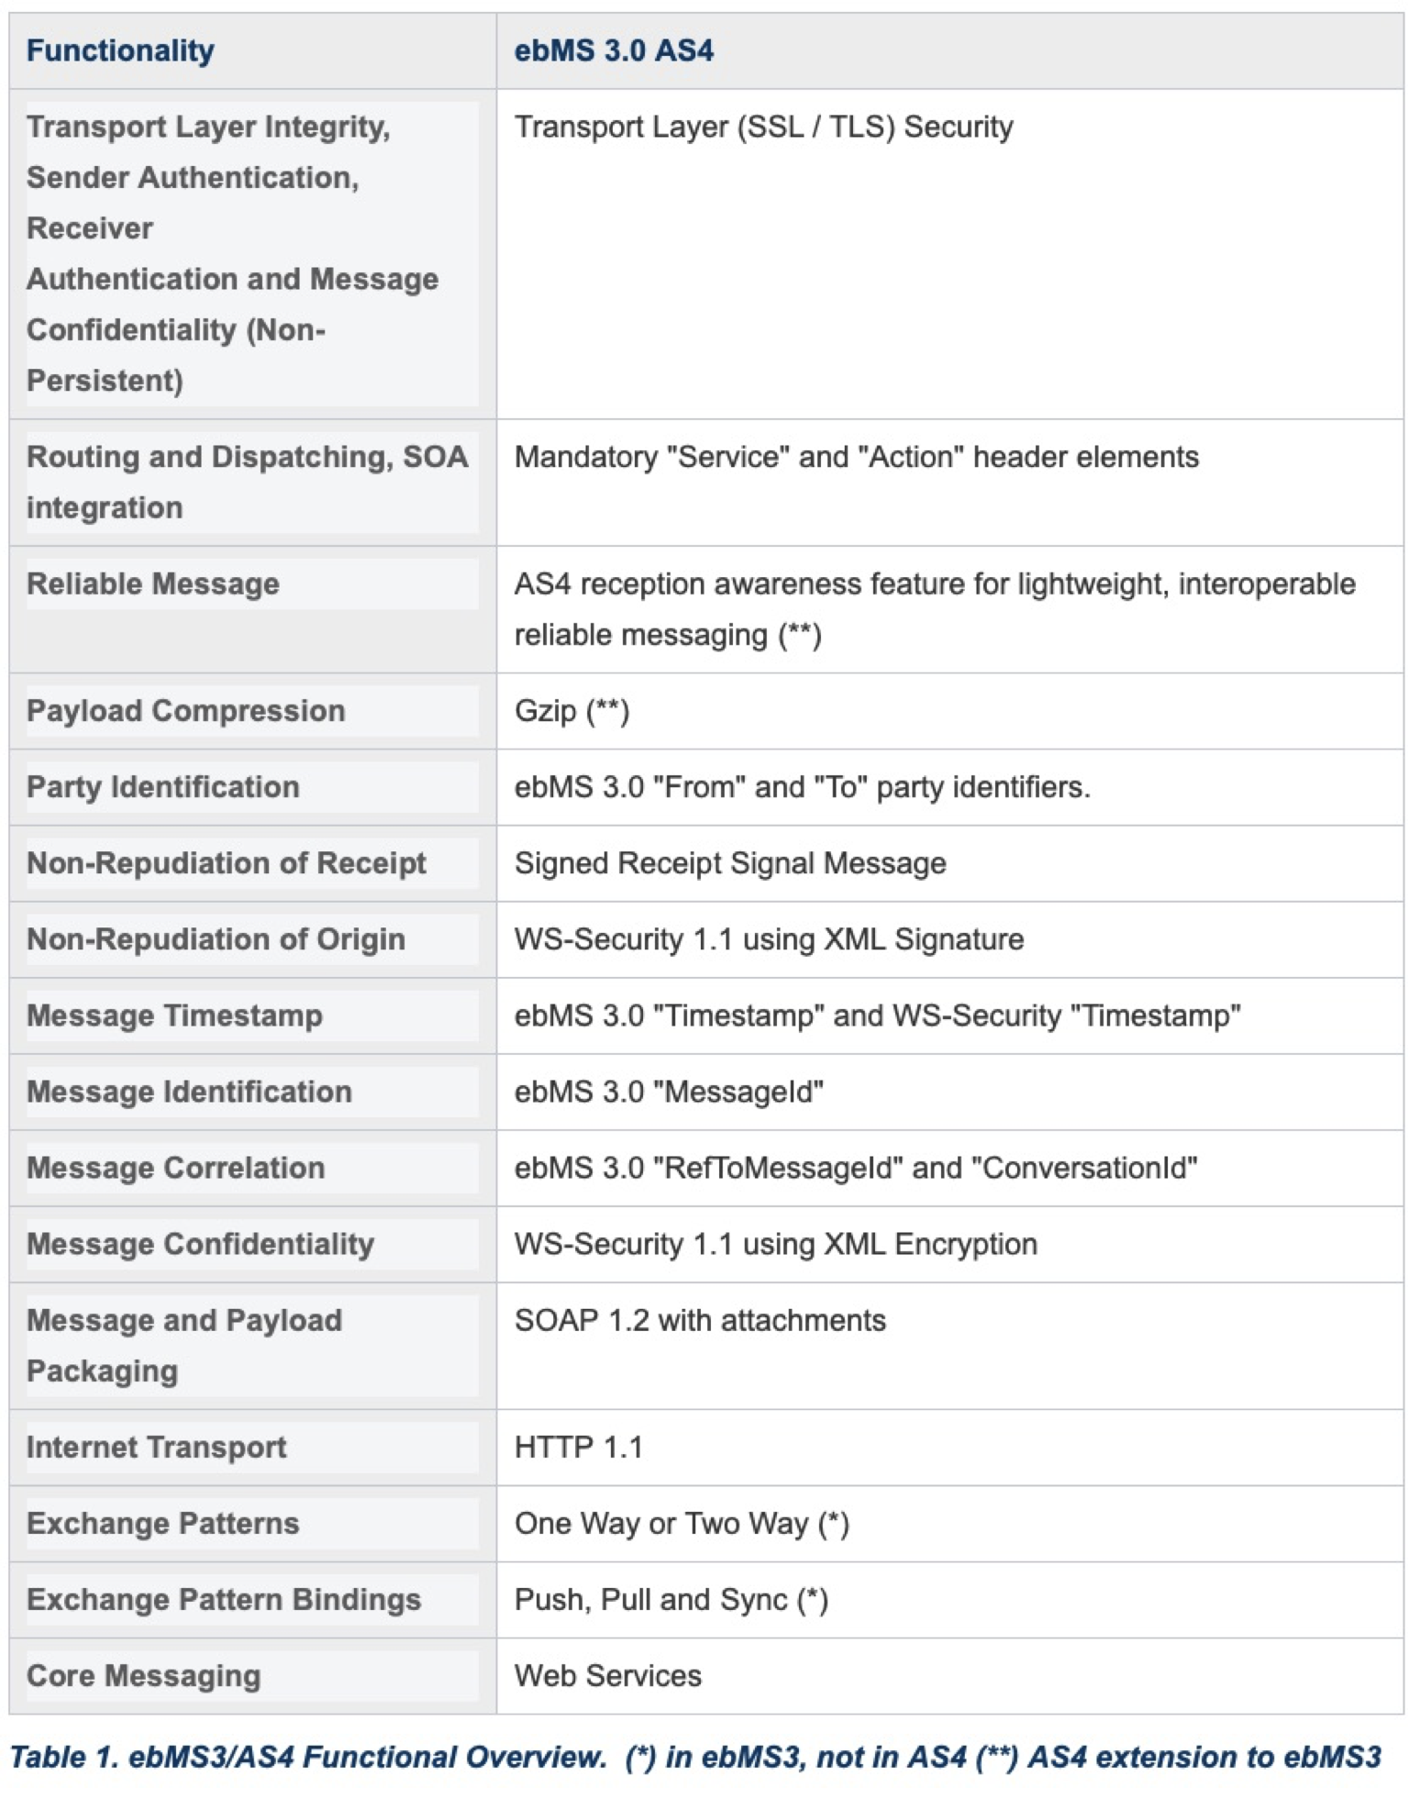
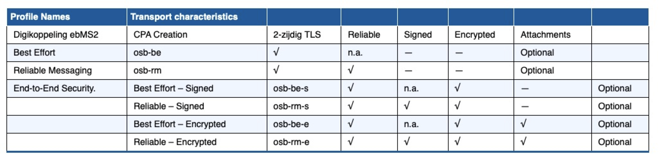
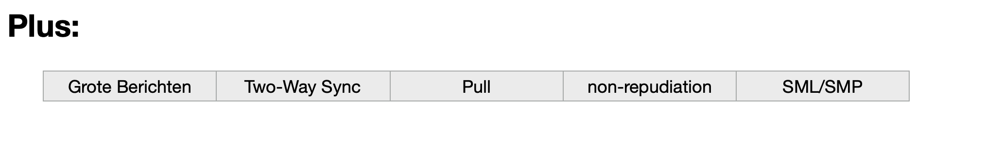
Digikoppeling

Slide 10
Links
DG DIGIT: https://commission.europa.eu/about-european-commission/departments-and-executive-agencies/informatics_en
eDelivery: https://ec.europa.eu/digital-building-blocks/wikis/display/DIGITAL/eDelivery
OASIS: https://www.oasis-open.org
ICN eDelivery: https://ec.europa.eu/digital-building-blocks/wikis/display/EDELCOMMUNITY/Informal+Cooperation+Network+for+eDelivery

Slide 11


betrouwbaar
gegarandeerd
veilig
www.rinis.nl

